Slide 1


Customer Shopping Behavior Analysis
Uncovering insights from 3,900 purchases to guide strategic business decisions through data-driven analysis of spending patterns, customer segments, and product preferences.

Slide 2
DATASET OVERVIEW
The Foundation: Our Data
3.9K
18
50
25
Total Purchases
Data Points
Locations
Products
Transactions analyzed across all categories
Features tracking demographics and behavior
Geographic diversity in customer base
Unique items across four categories
Dataset captures customer demographics, purchase details, and shopping behavior including age, gender, location, subscription status, product categories, purchase amounts, discounts, and review ratings.

Slide 3


PYTHON ANALYSIS
Data Preparation & Cleaning
01
02
Data Loading & Exploration
Missing Data Handling
Imported dataset using pandas, examined structure with df.info() and summary statistics
Imputed 37 missing Review Rating values using median rating per product category
03
04
Feature Engineering
Database Integration
Created age_group bins and purchase_frequency_days columns for deeper analysis
Connected to PostgreSQL and loaded cleaned data for SQL analysis

Slide 4
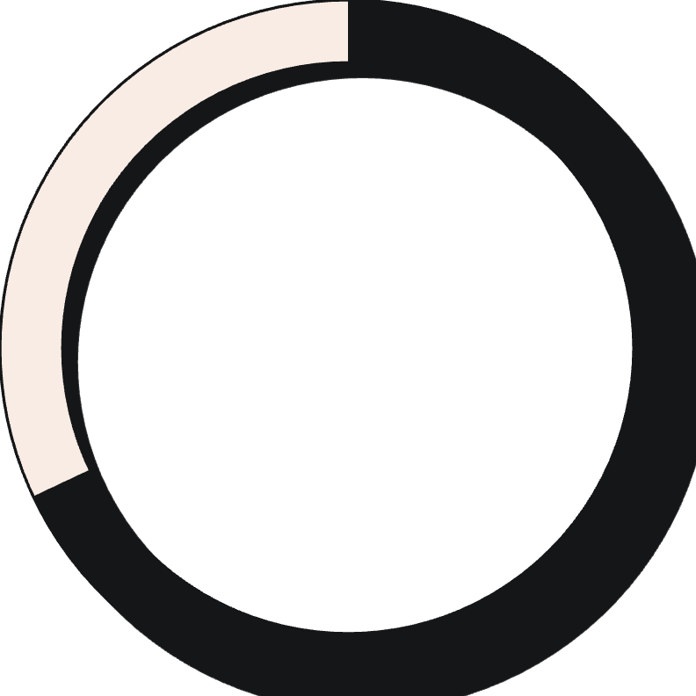

SQL INSIGHTS
Revenue Analysis: Key Findings
Gender Revenue Split
Smart Discount Users
Male customers generated $157,890 in revenue compared to $75,191 from female customers—more than double the contribution.
839 customers used discounts while still spending above the $59.76 average purchase amount, demonstrating price-conscious yet high-value behavior.
68%
32%
Male customer revenue share
Female customer revenue share

Slide 5
Product Performance Insights
Top Rated: Gloves
Sandals
Boots
Average rating: 3.86
Average rating: 3.84
Average rating: 3.82
Shipping Preferences
Discount-Dependent Products
Express shipping customers spend $60.48 on average vs. $58.46 for standard shipping—indicating willingness to pay premium for speed.
Hats lead with 50% discount rate, followed by Sneakers at 49.66% and Coats at 49.07%.

Slide 6
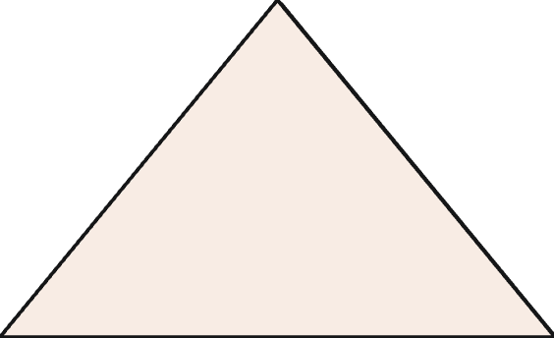


CUSTOMER SEGMENTS
Understanding Our Customer Base
New
1
83
Returning
2
701
Loyal
3
3,116
Customer segmentation reveals 80% loyal customers (3,116), with 701 returning buyers and only 83 new customers. This strong loyalty base presents opportunities for retention programs and upselling strategies.

Slide 7
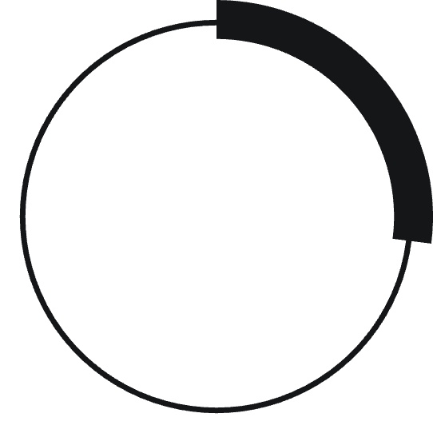

Subscription Status Analysis
Repeat Buyer Behavior
Among customers with 5+ purchases:
958 are subscribers
27%
2,518 are non-subscribers
Significant opportunity to convert loyal non-subscribers.
Subscribers
1,053 customers with avg spend $59.49
73%
Non-Subscribers
2,847 customers with avg spend $59.87
Despite similar spending patterns, only 27% of customers subscribe. Total revenue: subscribers contribute $62,645 while non-subscribers generate $170,436.

Slide 8

CATEGORY PERFORMANCE
Top Products by Category
Accessories
Clothing
Jewelry (171 orders)
Blouse (171 orders)
Sunglasses (161)
Pants (171)
Belt (161)
Shirt (169)
Footwear
Outerwear
Sandals (160 orders)
Jacket (163 orders)
Shoes (150)
Coat (161)
Sneakers (145)

Slide 9

POWER BI DASHBOARD
Visual Analytics Overview
Key Metrics Tracked
Interactive Filters
Revenue Insights
3.9K customers analyzed
Subscription status, gender, category, shipping type enable dynamic exploration of customer behavior patterns.
Young Adults lead revenue at $62,143, followed by Middle-aged ($59,197), Adults ($55,978), and Seniors ($55,763).
$59.76 average purchase
3.75 average review rating

Slide 10


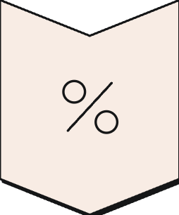

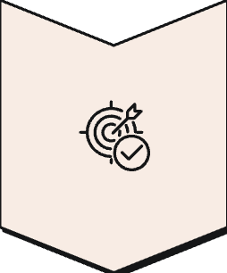
ACTION PLAN
Strategic Recommendations
Boost Subscriptions
Promote exclusive benefits to convert the 73% non-subscriber base, especially among repeat buyers.
Customer Loyalty Programs
Reward the 3,116 loyal customers to increase retention and move returning buyers into loyal segment.
Review Discount Policy
Balance sales boosts with margin control—839 customers use discounts while spending above average.
Product Positioning
Highlight top-rated products (Gloves, Sandals, Boots) and best-sellers in marketing campaigns.
Targeted Marketing
Focus on Young Adults ($62K revenue) and express-shipping users who demonstrate higher spending willingness.

